Slide 1

LAB 3 POLYMUMPs Battering Ram Arsh Dhillon 104932740

Slide 2
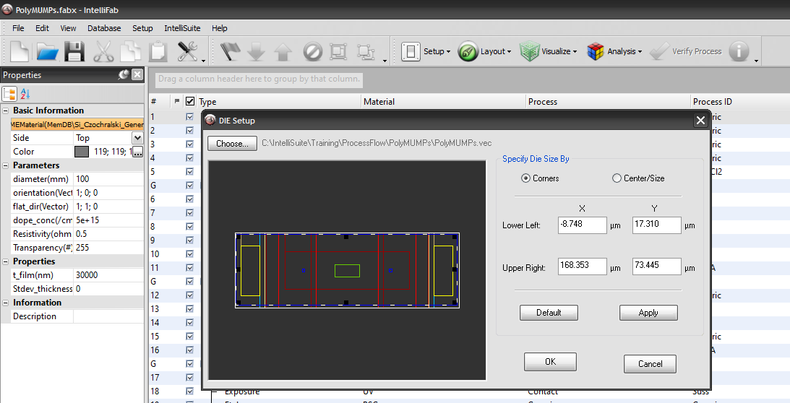
First, we open IntelliFab and then POLYMUMPs.fabx to load a sample blueprint (POLYMUMPs.vec) in order to better understand the deposition and fabrication steps.

Slide 3
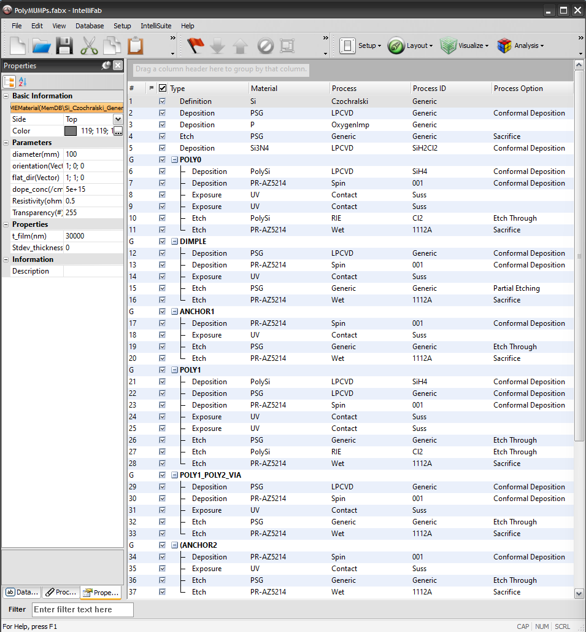
Here are the deposition steps for fabricating POLYMUMPs.vec. 3 layers of polysilicon with etching, deposition and lithography. This hierarchy is later useful in fabricating the Battering Ram.

Slide 4
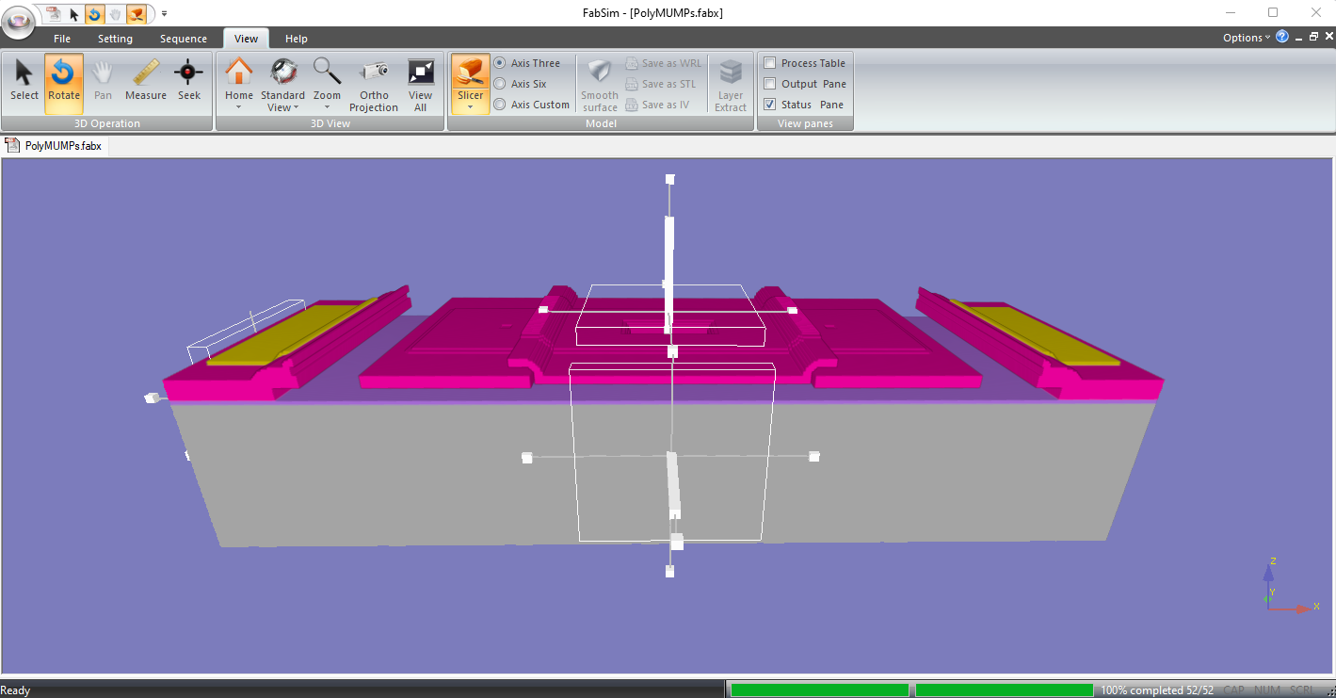
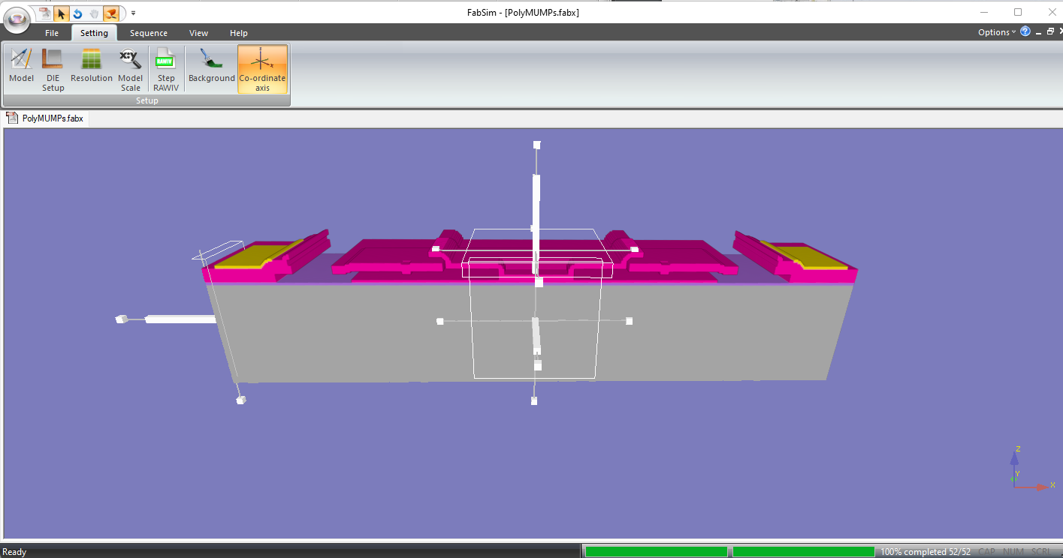
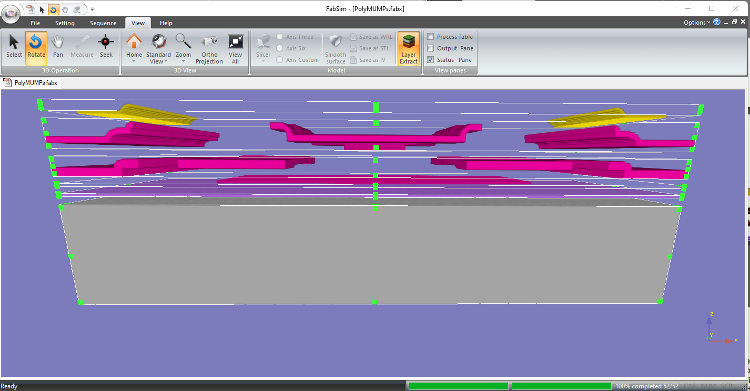
Below are the FabSim visuals of the fabrication of POLYMUMPs.vec. Slicer tool and exploded view is used for better inspection of all the layers.

Slide 5
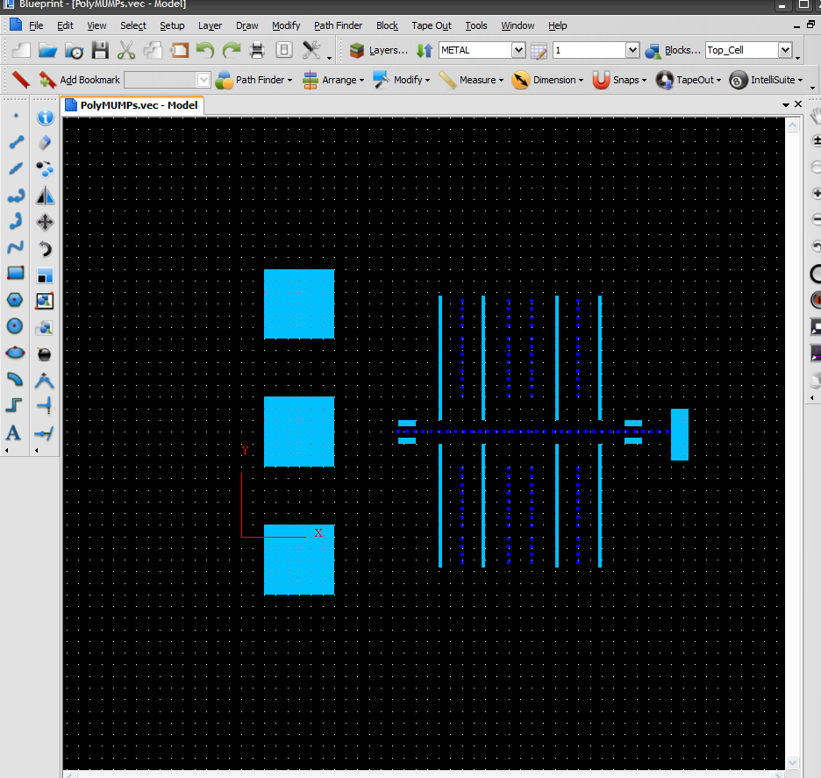
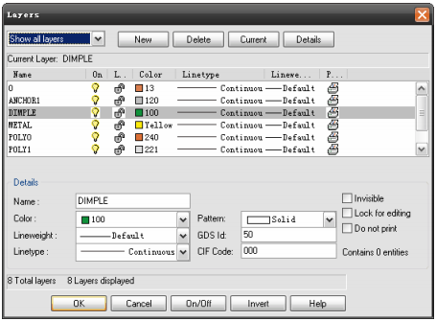
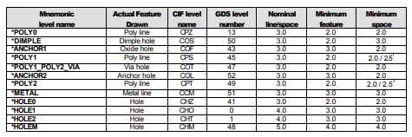
Now we start the design process of our battering ram. We define 12 different layers for our blueprint as shown above. We draw the barebones anchoring schematic in the ANCHOR 1 layer. All the small boxes in between belong to the DIMPLE layer.

Slide 6
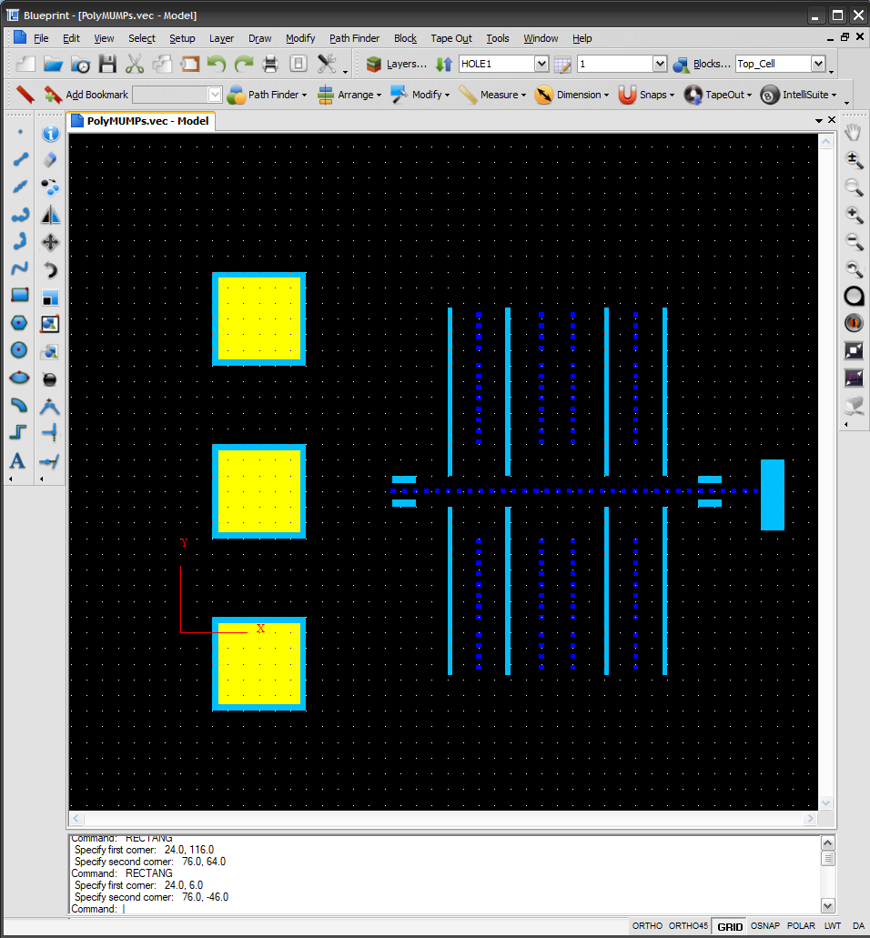
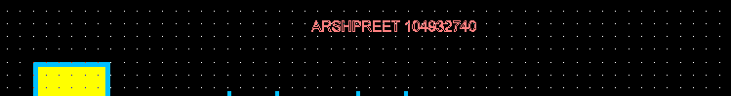
Now we use the METAL layer to draw 3 more squares over the ANCHOR 1 layer. These new square are smaller in size and fit flush over the ones before them. The minimum and nominal sizing rules are followed as shown in the box above for all designing steps.

Slide 7
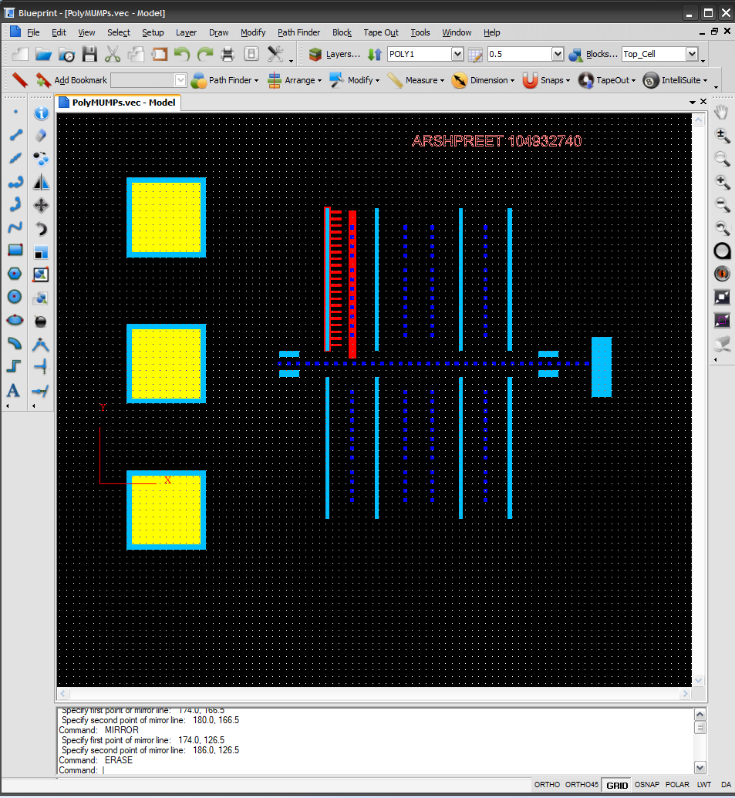
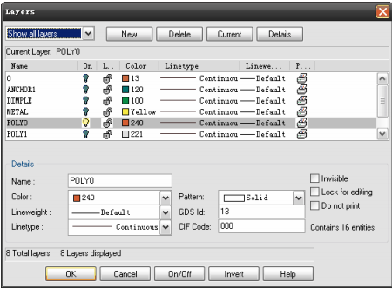
We start designing our first PolySilicon layer POLY 0. We design the comb teeth and the shafts that encompasses the ANCHOR 1 bones.

Slide 8
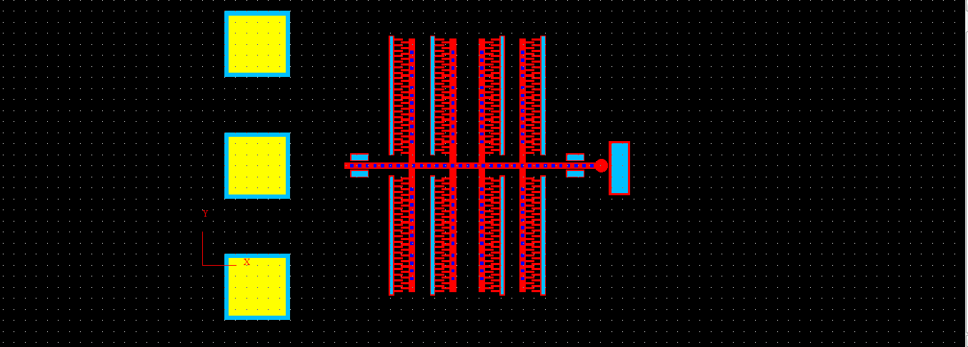
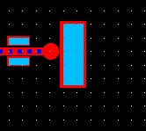
We finish the above schematic in red in the POLY1 layer. Zoomed look at the head of the battering ram.

Slide 9
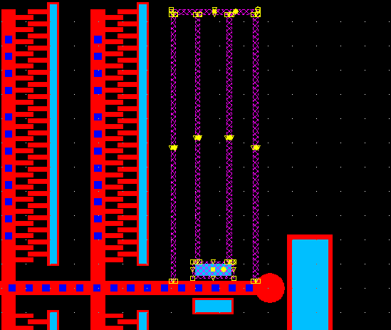
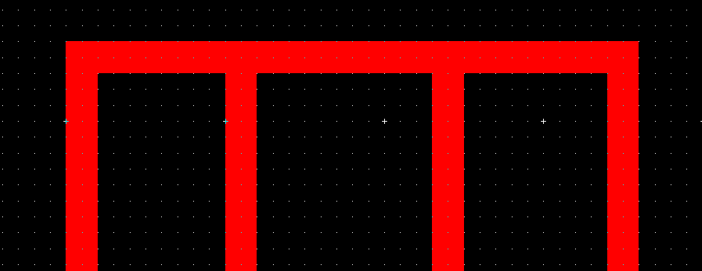
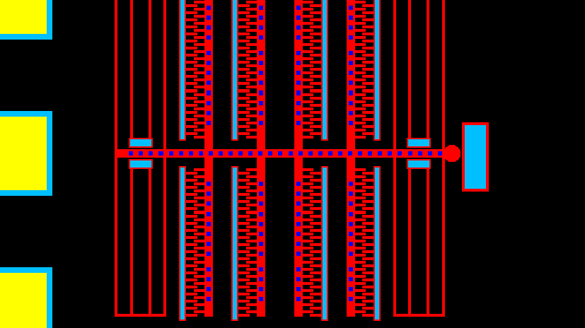
Next we design the arms of the POLY1 layer according to the nominal design metrics. These bars are Combined using Path Finder -> Union to create a single unit. Next we use Mirror to replicate this around the existing structure. Lastly, we select all the POLY1 blocks and create a single unit.

Slide 10
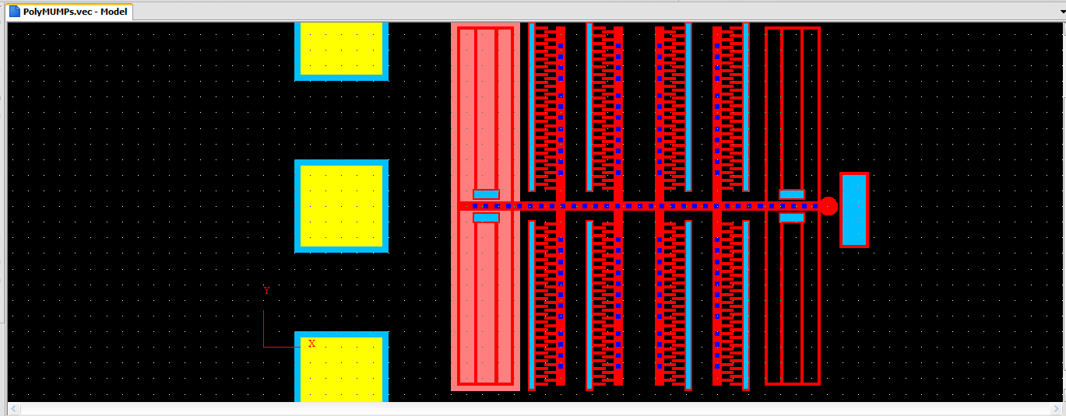
Next on we move to the POLY0. We create three more squares and encompass the existing structure, creating sets of three different “wires” that lead to the former blocks.

Slide 11
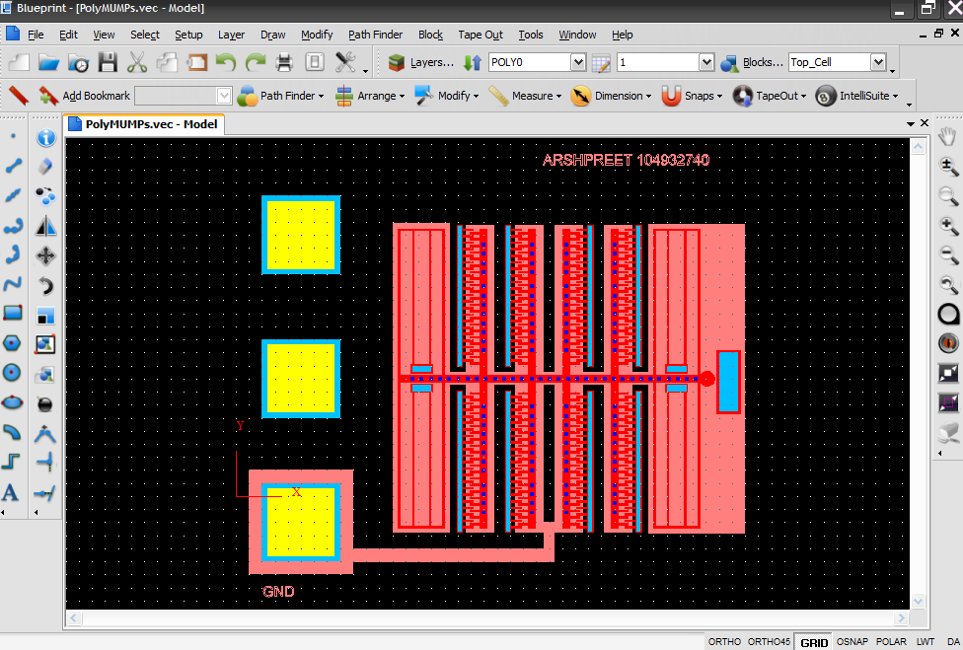
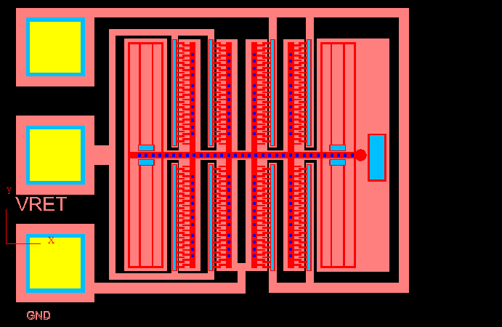
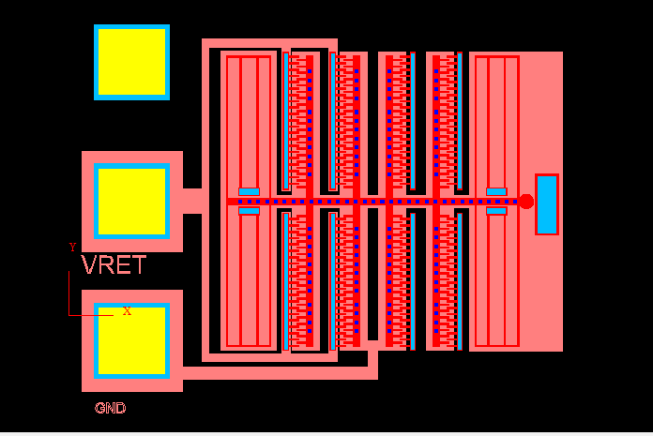
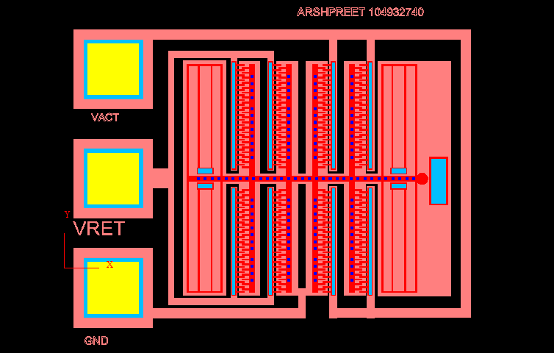
POLY0 Layer schematic. Blocks are named VACT, VRET and GND in order from top to bottom. They are subsequently connected to their respective POLY0 contacts. We again use Union to connect all these blocks as 3 separate entities. Lastly we proceed to POLY2 and draw last 3 blocks in POLY2

Slide 12
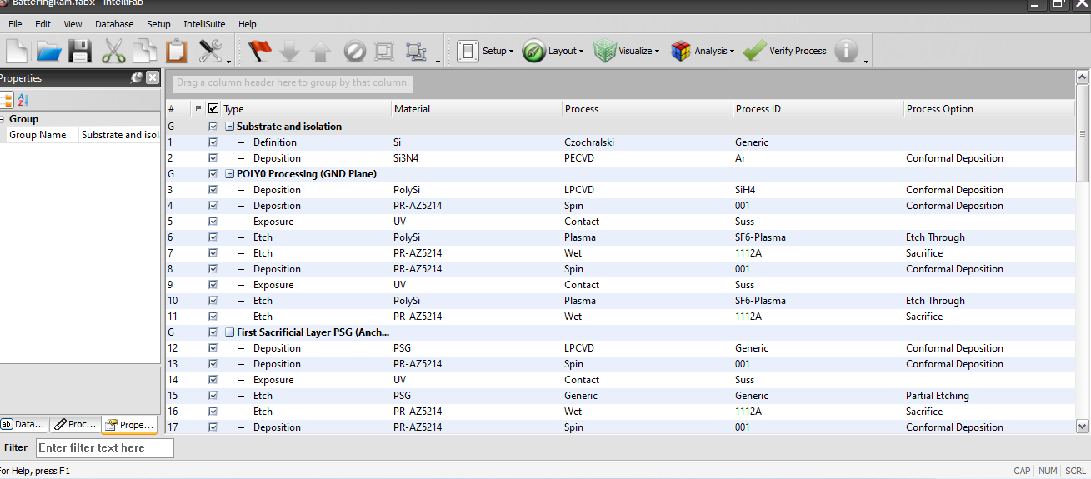
We finish our designing and save the Blueprint as POLYMUMPs.vec. Next we load up our IntelliFab and use the fabrication steps outlined in the Handguide to create the above process fabrication table.

Slide 13
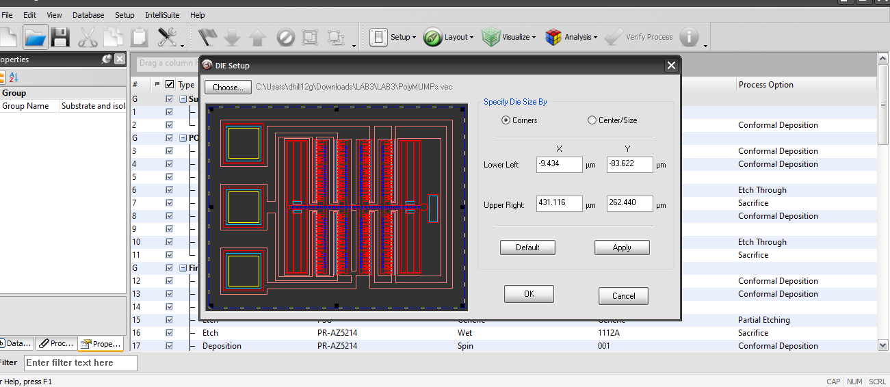
Next we load up our POLYMUMPs.vec file in order to implement the battering ram design to in the IntelliFab process file. We select an appropriate die size and click OK.

Slide 14
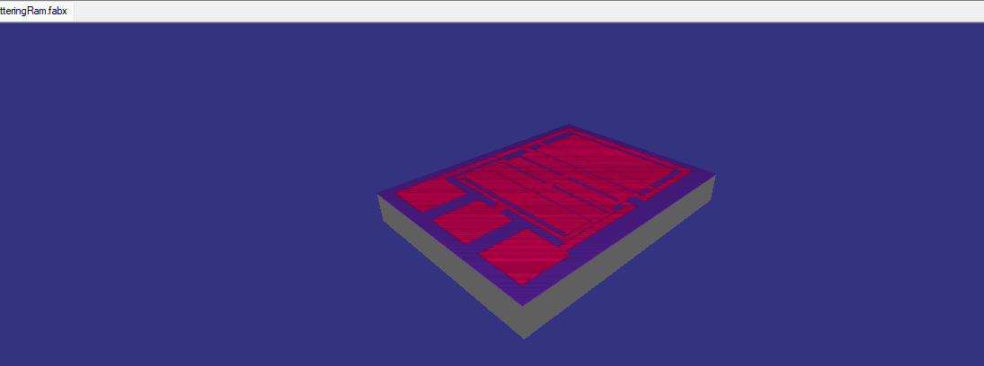
Next we use FabSim module to simulate the fabrication of our final Battering Ram. An intermediate slide in the 58 process table is shown above.

Slide 15
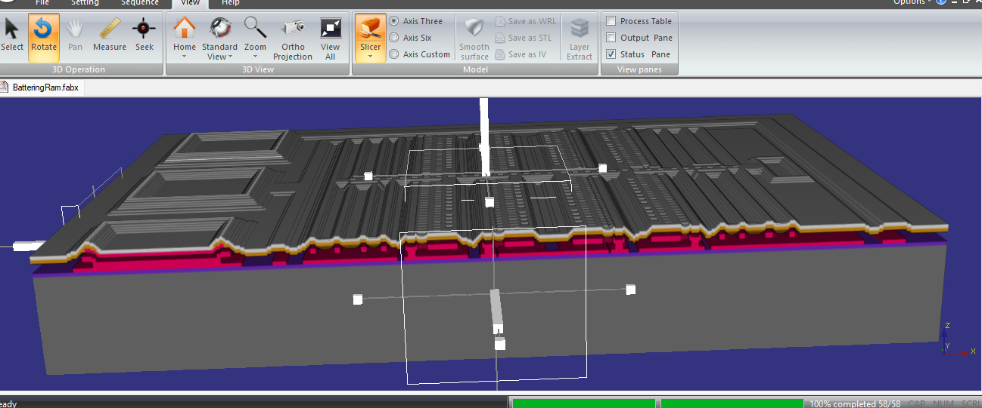
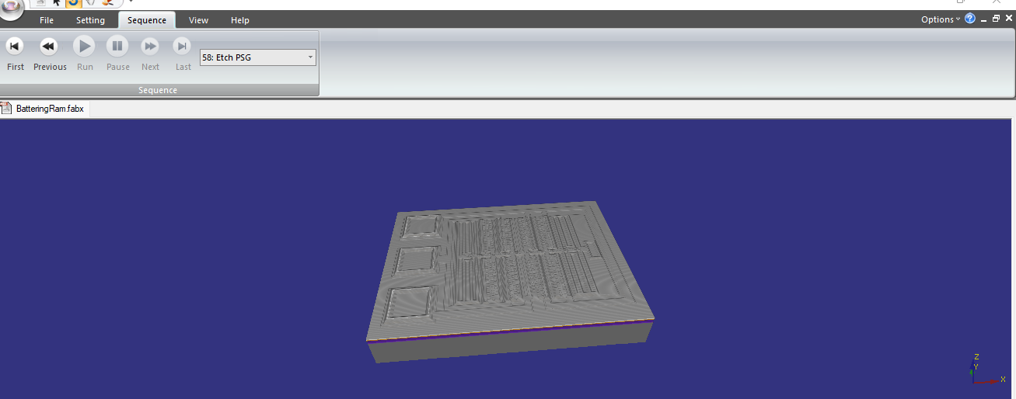
Shown here is our battering ram as completed in the simulation. Slicer tool is used to show the cross sectional view of the die.

Slide 16
Deposition Steps 2 Deposition Si3N4 PECVD Ar Conformal Deposition 3 Deposition PolySi LPCVD SiH4 Conformal Deposition 4 Deposition PR-AZ5214 Spin 001 Conformal Deposition 8 Deposition PR-AZ5214 Spin 001 Conformal Deposition 12 Deposition PSG LPCVD Generic Conformal Deposition 13 Deposition PR-AZ5214 Spin 001 Conformal Deposition 17 Deposition PR-AZ5214 Spin 001 Conformal Deposition 21 Deposition PolySi LPCVD SiH4 Conformal Deposition 22 Deposition PR-AZ5214 Spin 001 Conformal Deposition 26 Deposition PR-AZ5214 Spin 001 Conformal Deposition 30 Deposition PSG LPCVD Generic Conformal Deposition 31 Deposition PR-AZ5214 Spin 001 Conformal Deposition 35 Deposition PR-AZ5214 Spin 001 Conformal Deposition 39 Deposition PolySi LPCVD SiH4 Conformal Deposition 40 Deposition PR-AZ5214 Spin 001 Conformal Deposition 44 Deposition PR-AZ5214 Spin 001 Conformal Deposition 48 Deposition PR-S3800 Spin S3810 Conformal Deposition 49 Deposition PR-AZ5214 Spin 001 Conformal Deposition 53 Deposition Al Sputter Ar-Ambient Conformal Deposition 54 Deposition PR-AZ5214 Spin 001 Conformal Deposition

Slide 17
Lithography 5 Exposure UV Contact Suss 9 Exposure UV Contact Suss 14 Exposure UV Contact Suss 18 Exposure UV Contact Suss 23 Exposure UV Contact Suss 27 Exposure UV Contact Suss 32 Exposure UV Contact Suss 36 Exposure UV Contact Suss 41 Exposure UV Contact Suss 45 Exposure UV Contact Suss 50 Exposure UV Contact Suss 55 Exposure UV Contact Suss

Slide 18
Etching 6 Etch PolySi Plasma SF6-Plasma Etch Through 7 Etch PR-AZ5214 Wet 1112A Sacrifice 10 Etch PolySi Plasma SF6-Plasma Etch Through 11 Etch PR-AZ5214 Wet 1112A Sacrifice 15 Etch PSG Generic Generic Partial Etching 16 Etch PR-AZ5214 Wet 1112A Sacrifice 19 Etch PSG Generic Generic Etch Through 20 Etch PR-AZ5214 Wet 1112A Sacrifice 33 Etch PSG Generic Generic Partial Etching 34 Etch PR-AZ5214 Wet 1112A Sacrifice 37 Etch PSG Generic Generic Partial Etching 38 Etch PR-AZ5214 Wet 1112A Sacrifice 42 Etch PolySi Plasma SF6-Plasma Etch Through 43 Etch PR-AZ5214 Wet 1112A Sacrifice 46 Etch PolySi Plasma SF6-Plasma Etch Through 47 Etch PR-AZ5214 Wet 1112A Sacrifice 51 Etch PR-S3800 Wet 1112A Partial Etching 52 Etch PR-AZ5214 Wet 1112A Sacrifice 56 Etch Al Wet PAN Partial Etching 57 Etch PR-AZ5214 Wet 1112A Sacrifice 58 Etch PSG Generic Generic Sacrifice

Slide 19
Overall, the lab was a success. We were successfully able to create our battering ram using Blueprint. Then we used IntelliFab to successfully realize it in FabSim. A video of the fabrication is attached in the zip file.

